Slide 1

Adversarial Patches Attack Transparency in Industrial Applications
ACHTATOU Sean
Presented for the Master Thesis of MICS

Slide 2
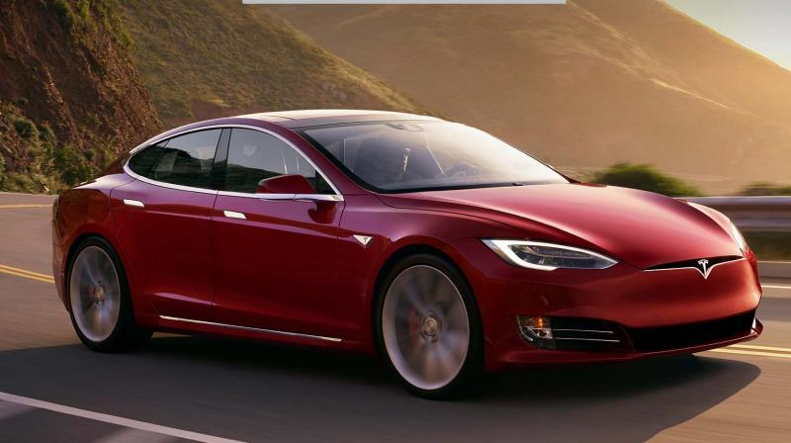
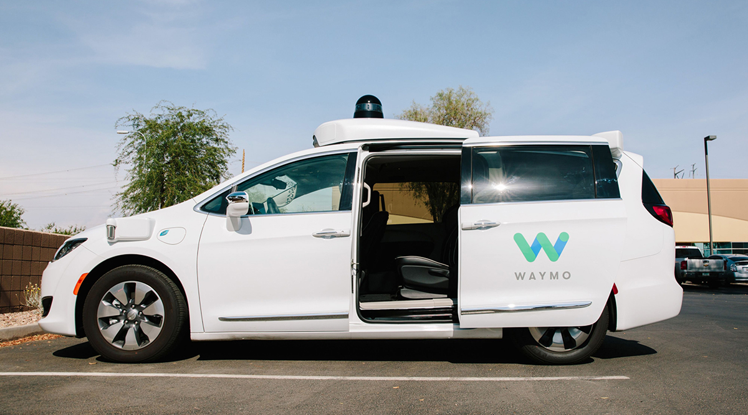
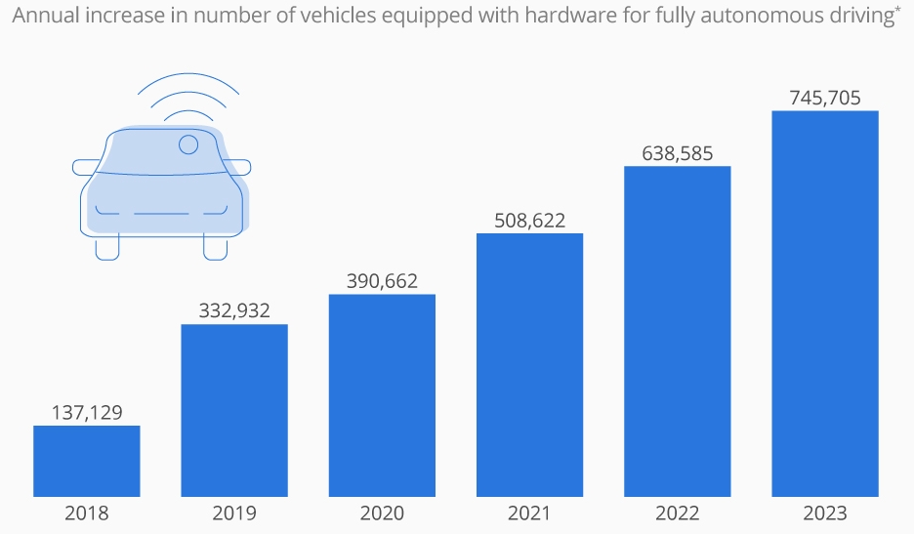
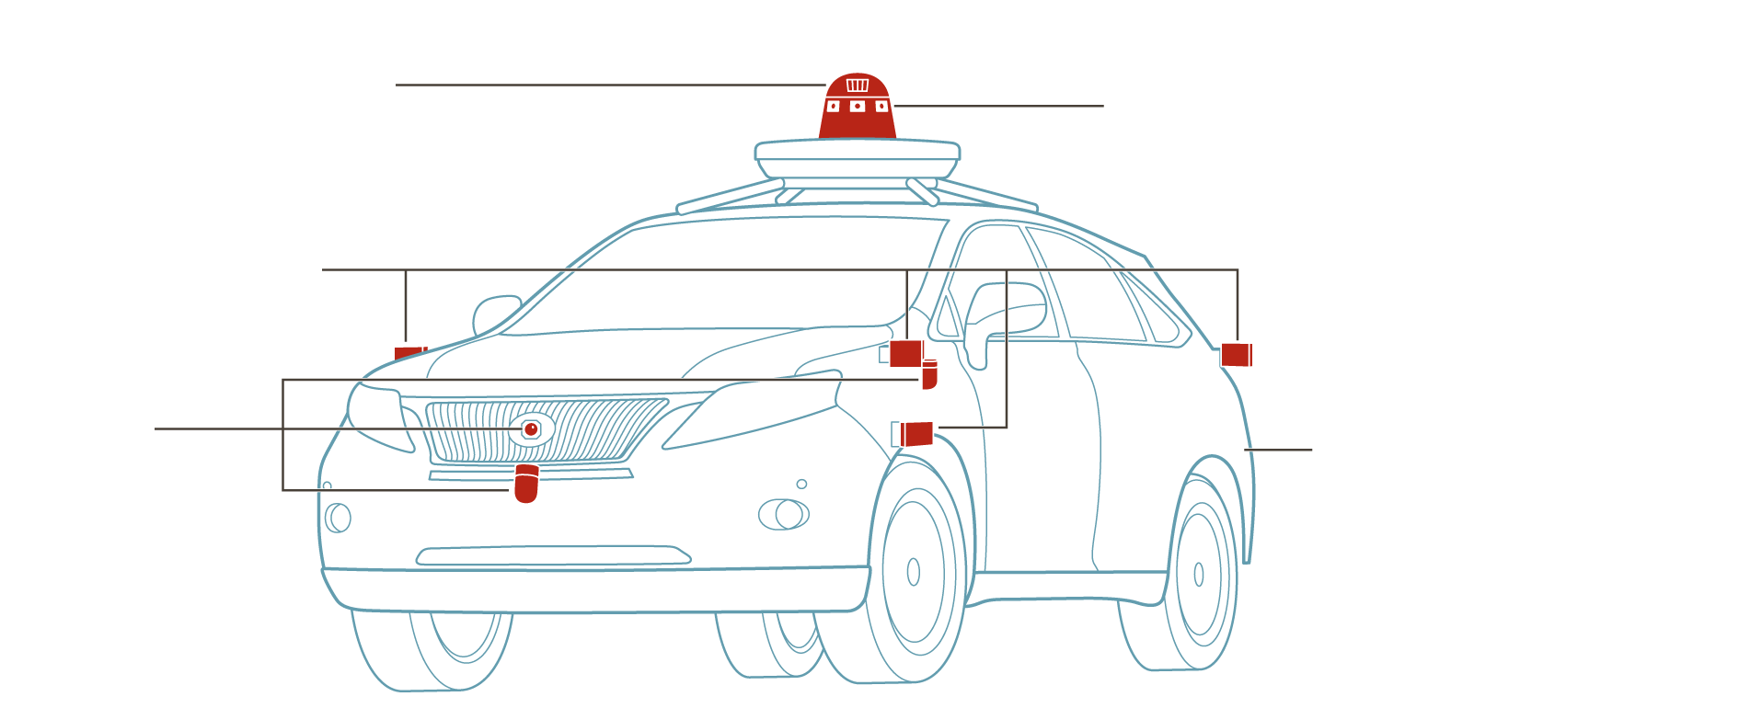
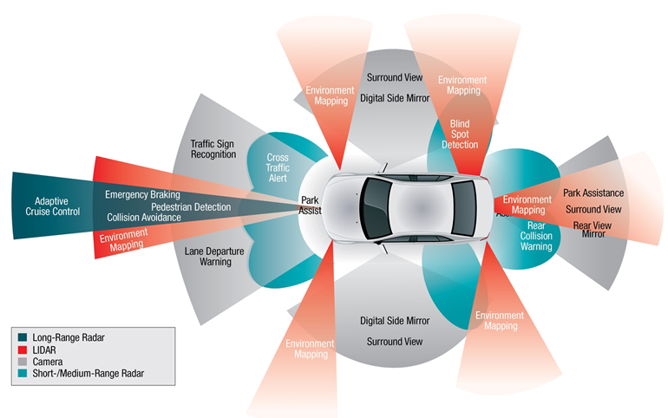
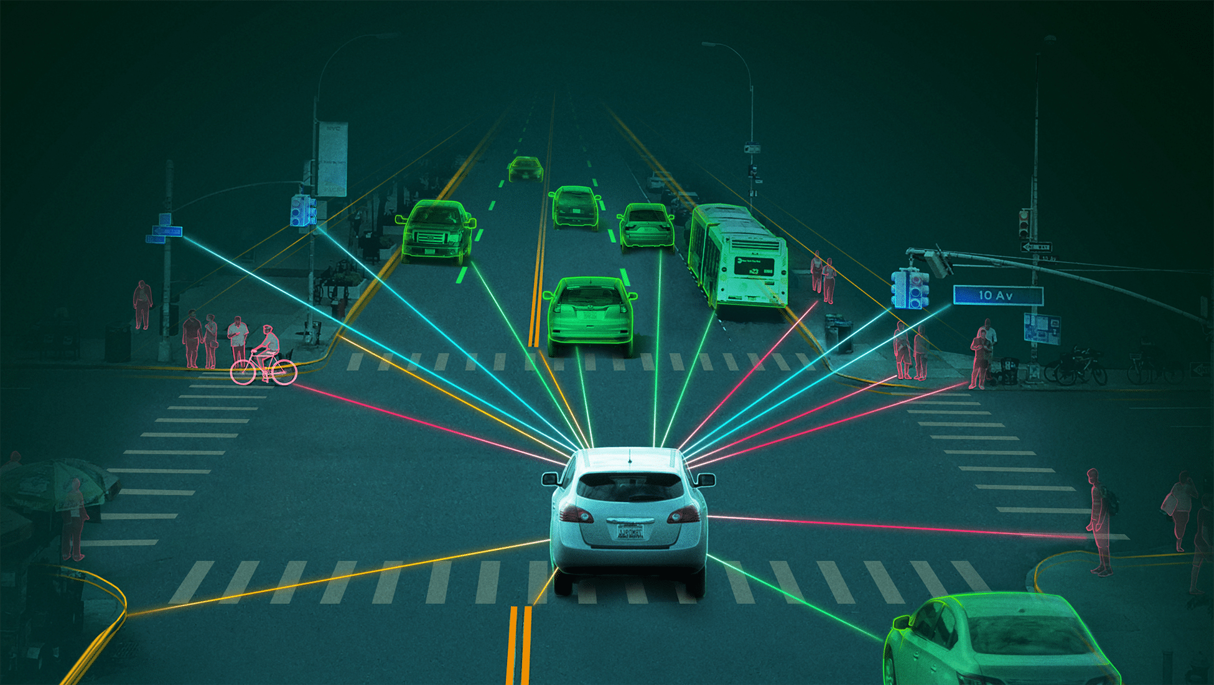
The Autonomous Vehicles in Industries
Nowadays, Computer Science have managed to provide many technologies and methods to help humanity in its daily routine.
      Websites
      Phones and Computers
      Security (keypad, home alarms,…)
      Artificial Intelligence (detection, classification,…)
      …
      Autonomous Vehicles (Tesla, Waymo,…)
Autonomous vehicles are composed of multiples sensors.
      LIDAR
      Radar (long range and short range)
      GPS
      Sonar
      Cameras

Slide 3
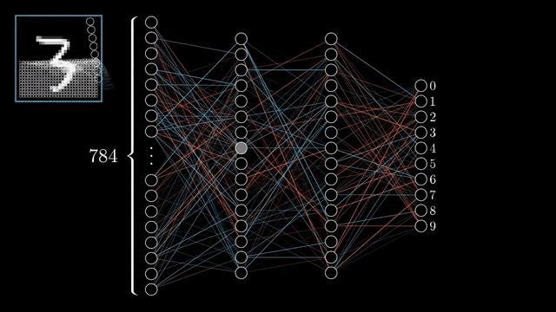
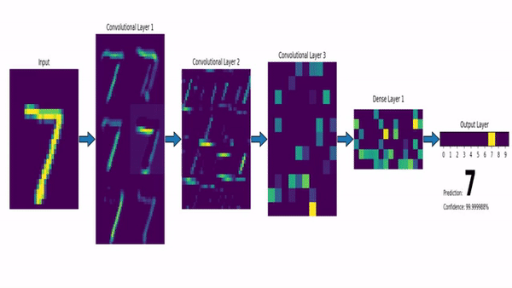
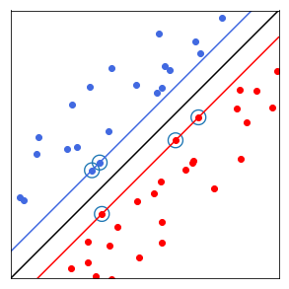
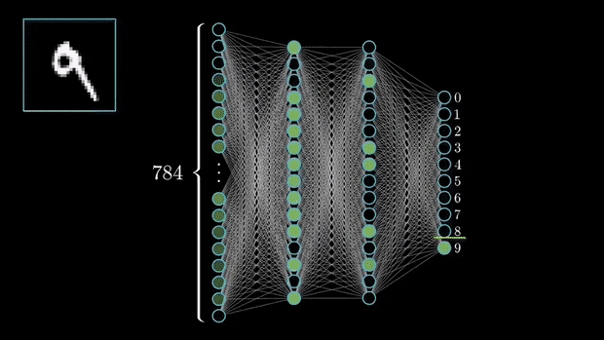
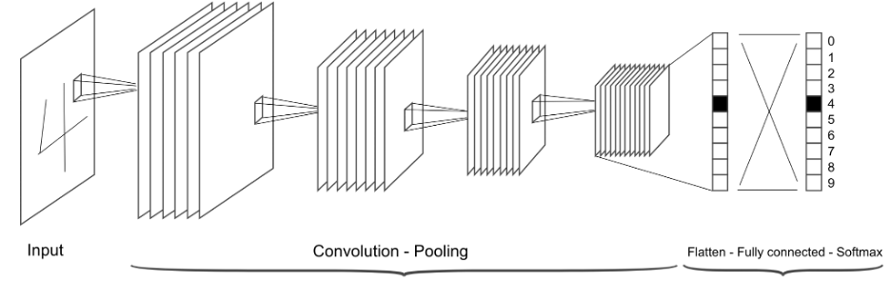
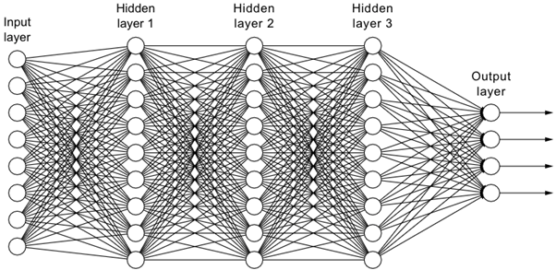

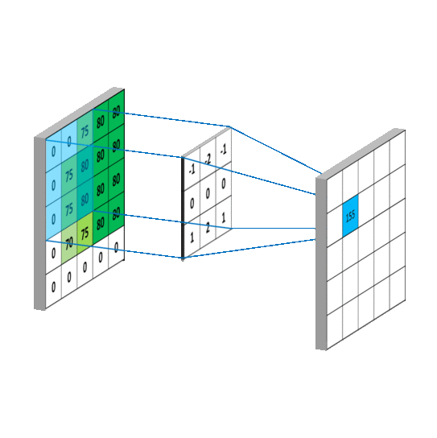
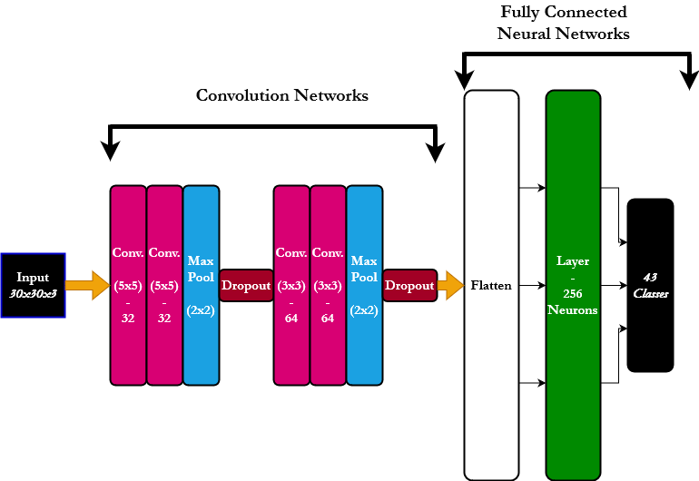
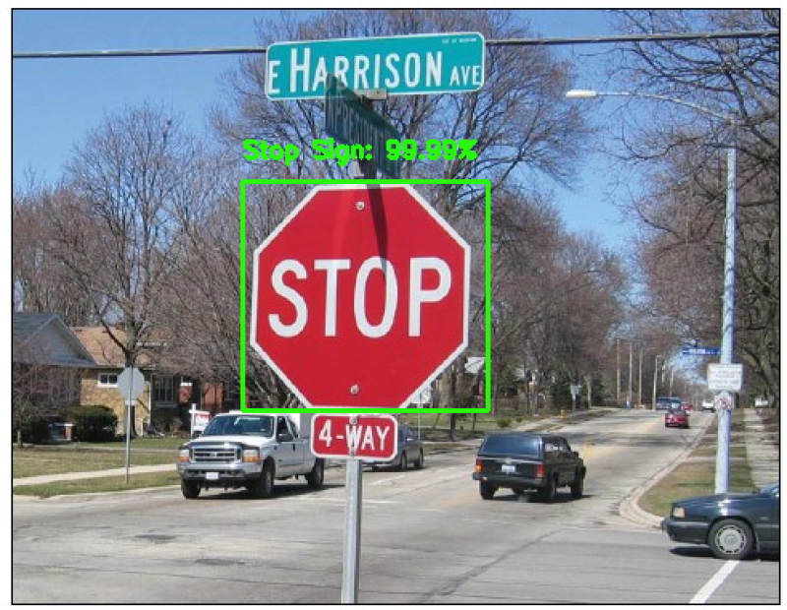
Artificial Intelligence - Convolutional Neural Network
The domain of Artificial Intelligence may be divided into two main categories.
      Machine Learning (regressions, SVM, K-NN, decision trees,…)
      Deep Learning (neural network, convolutional neural network,…)
!

Slide 4
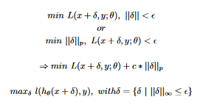
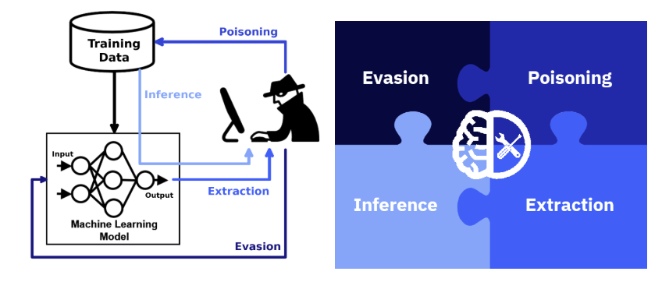
Artificial Intelligence – Attacks
The objective of the Convolutional Neural Network model θ is to operate on the classification
tasks it has been defined for, minimizing the loss L of a data x and their corresponding labels y.
The objective of an attack is to minimize (maximize) a loss L with the use of an adversarial perturbation δ on a sample x on model θ, in order to produce an alternated desired output y (y’).
Artificial Intelligence models have been subject to numerous of adversarial attacks, which objective is the miss-classification of the model. The idea is to apply the inverse technique originally used in order to train the model, and trying to maximize the loss of the model to miss-lead its behaviour.
There exists different types of attacks based on how the model is being attacked, and defined in four categories:
  Evasion Attacks (manipulating the input data to evade a trained classifier at run time. The attacker is modifying the input in order for the model to miss-classify)
  Poisoning Attacks (increasing the number of miss-classified samples at testing time by injecting poisoned samples in the training data)
  Inference Attacks (probing the model with different inputs, and analysing the corresponding outputs to obtain information regarding the data used)
  Extraction Attacks (similar to inference attacks, stealing the information about the structure of the model)

Slide 5
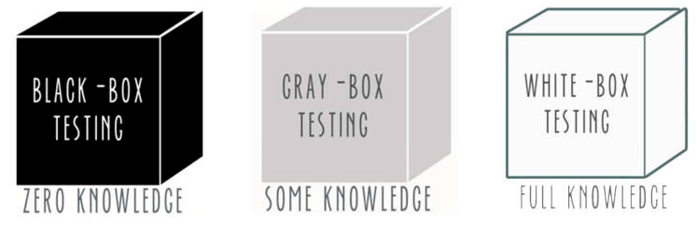
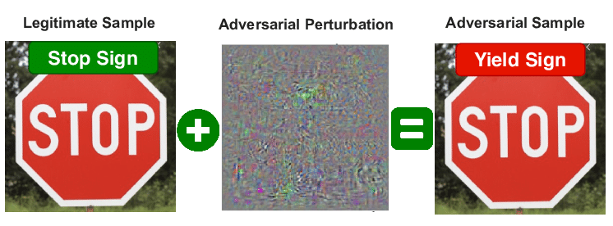
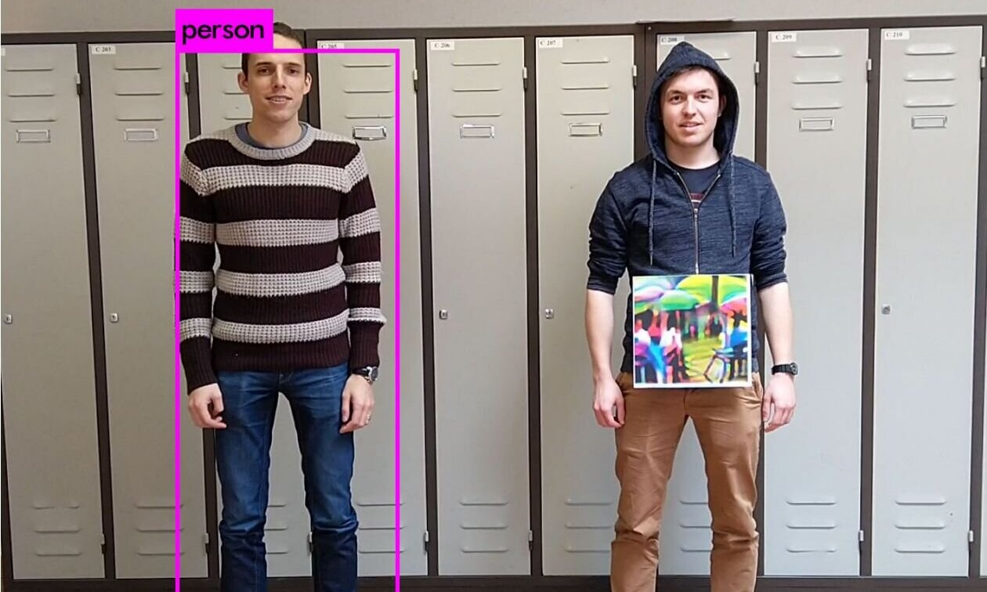
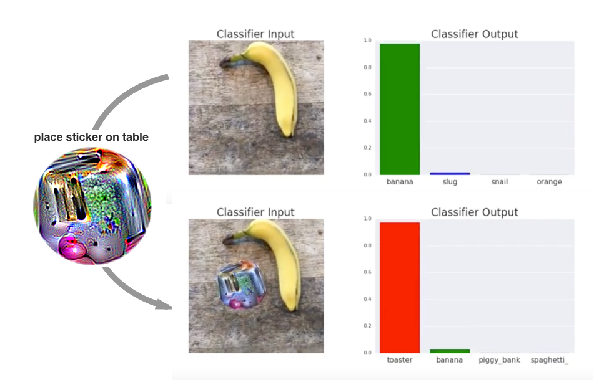
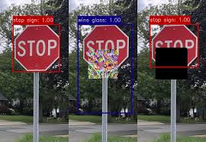
Artificial Intelligence – Attacks [2]
There exists multiples ways to attack an AI model. Different types of models, information and structure, require alternated strategies based on the adversary capabilities knowledge of the model structure and information.
The strategies may be divided in three categories:
    Black-Box Attacks - The adversary has no access to the model structure (surrogate classifier, genetic algorithm)
    Gray-Box Attacks - The adversary has access to some of the structure and the information of the Model
    White-Box Attacks - The adversary has access to the structure and the information of the Model (F-BGFS,FGSM,JSMA)
The Adversarial Patches in Black-Box Attacks using Genetic algorithm!

Slide 6
Artificial Intelligence – Attacks [3]
With existing Adversarial Patches attacks, we may observe obvious potential issues in the following examples…
The visibility and feasibility of the attack!
We want to create an attack, targeting the images of the cameras of autonomous vehicles regarding the detection of traffic signs (model for traffic sign detection), that minimize the visibility of the adversarial patch (visibility), that the adversarial patch defined can be manipulable in a real environment (feasibility), while the attack remains as efficient as existing attacks (efficiency).
Defining the attack properties and parameters:
    Black-Box
    The attack is based on “Black-Box”, therefore we do not have access to the model parameters and/or structure, we may only be able to probe the model for set of inputs/outputs. For the purpose of this research, we have created our own traffic sign classifier.
    Genetic Algorithm
    The attack is based on the “Genetic Algorithm” (pymoo), it will be applied in order to produce the adversarial patches capable to attack the original model by modifying the original images prediction after being applied on these.
    Target Position
    We must take into account the target position (traffic sign). For the produced adversarial patch to be applicable in a real world environment.
    Patch Form
    We must take into account the adversarial patch form. Allowing multiples types of forms to be applicable (circle, square, triangle) for extendibility and usability of the adversarial patch in different situations.
    Patch Structure
    We must take into account the content of the patch. The visibility of the adversarial patches produced must be minimized based on the target attacked.
    Autonomous Vehicles Camera
    The attack should applicable (at least) in the domain of the traffic sign detection of the autonomous vehicles.

Slide 7
Research Questions
Based on the observed issues of existing attacks, and the definition of our attack properties and parameters, we may define our research questions.
R1 - How to restrict the visibility of the adversarial patches from the human factor?
R2 - Is producing Adversarial Patches of different forms and size, delivering similar attack
efficiency?
R3 - Can we apply Pymoo to produce adversarial patches fulfilling the restriction in the
visibility and attack position, but still being efficient?
AdversarialColorPatch (ACP)

Slide 8
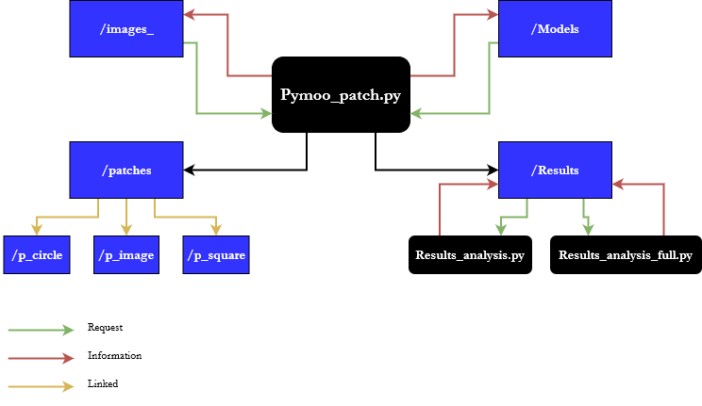
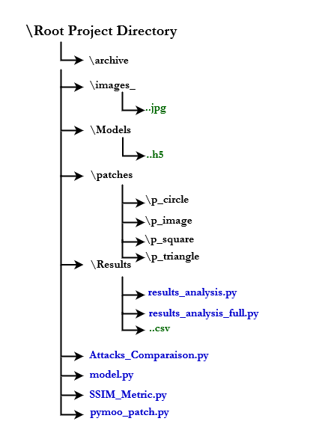
AdversarialColorPatch (ACP)
AdversarialColorPatch(ACP) - The AdversarialColorPatch is a Black-Box attack based on the use of pymoo genetic algorithm to produce adversarial patches of different forms and sizes, related to the colour domain of the attacked target. It may be applied for Target, Untarget and Best attacks.
AdversarialColorPatch parameters:
    Model Type (keras, pyTorch)
    Images Selections
    Model Selections
    Attacks Selections (target,untarget,best)
    Adversarial Patch Form (circle,square,triangle)
    Shape of Target (circle,square,triangle)
    Amount of Adversarial Patches
AdversarialColorPatch sections and structure:
    Genetic Algorithm (pymoo)
    What is a genetic algorithm, and how did we apply Pymoo for our attack.
    Colour
    How did we define the colour domain relation and threshold for the adversarial
    patches
    Attacks
    Definition of the three possible attacks to be applied with ACP.
    Algorithm
    Overview of the full algorithm for ACP.
    Examples

Slide 9
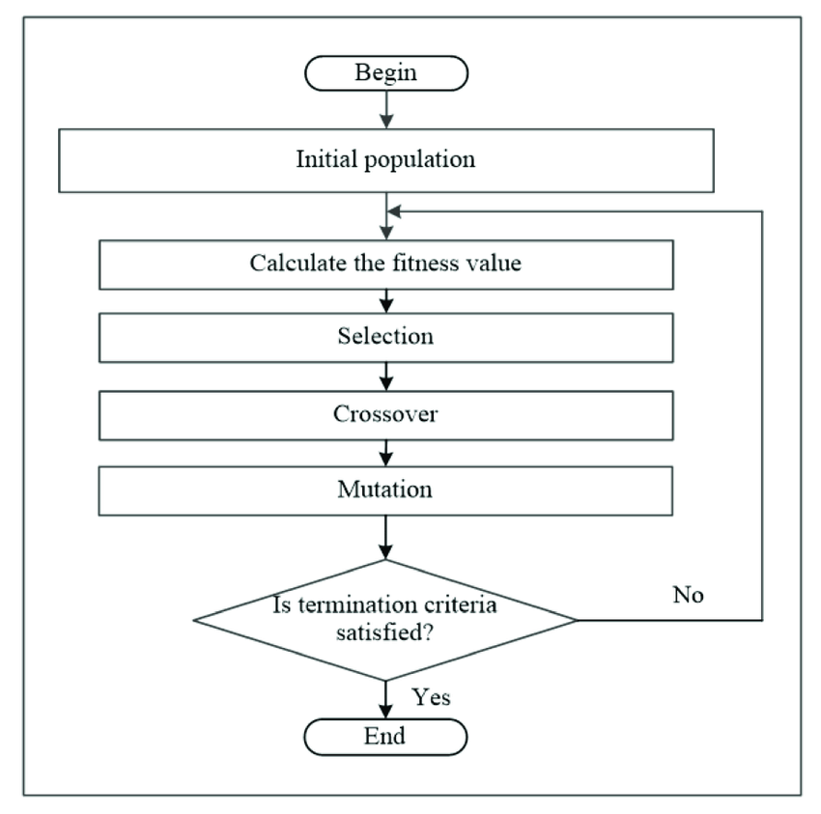
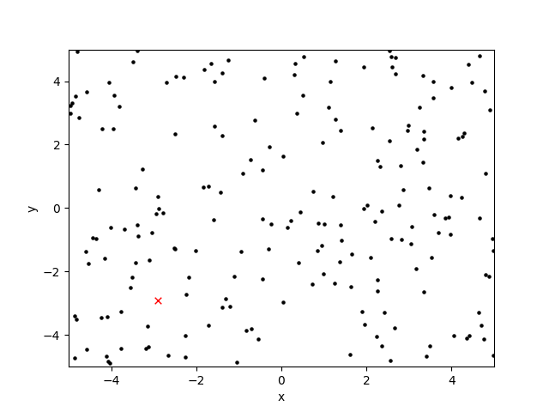
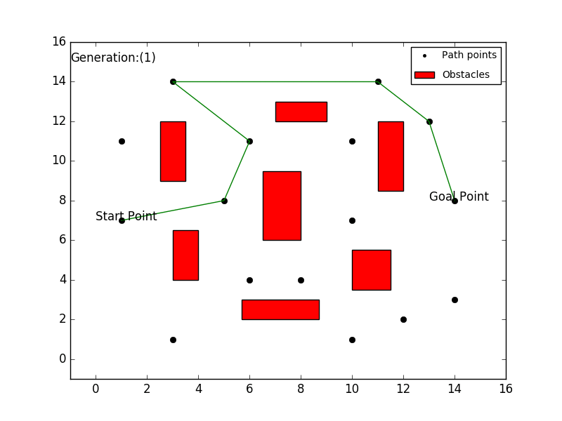
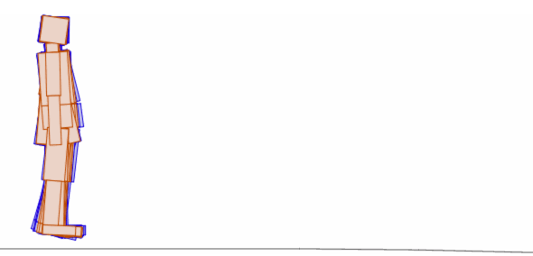
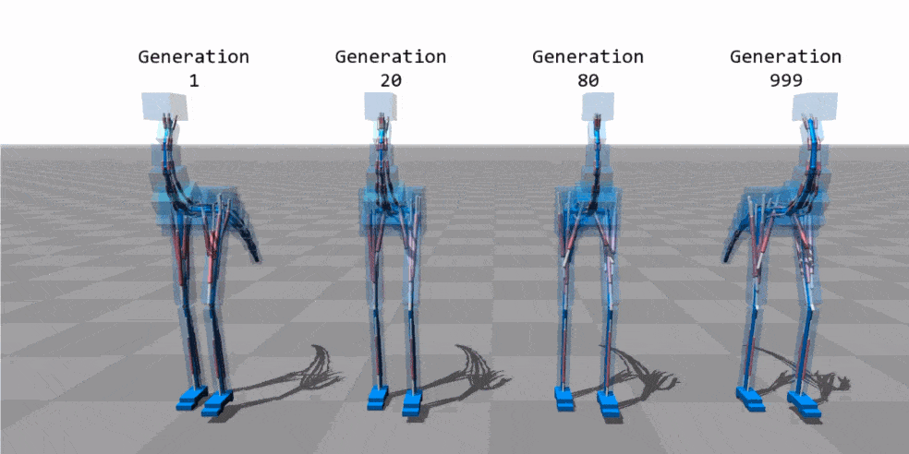

AdversarialColorPatch – Genetic Algorithm (pymoo)
Genetic Algorithm - The genetic algorithms (GA) are the most basics and earliest type of evolutionary algorithms. This algorithm is based on the use of candidates, similarly called chromosome, belonging to a population, where each of the candidate carry as set of variables, similarly called gene, that need to be optimized.
Pymoo - Pymoo is a multi-objective optimization framework providing multiples all-ready evolutionary algorithms, that can be altered for the sake of a distinct problem. It does provide diverse algorithms based on evolutionary behaviours, that can be modified for solving a specific optimization task.
Pymoo settings:
  Input parameters
  Threshold limitation on the Input parameters
  Hyperparameters – Population, Generations, Selection, Mutations
  Objective function
(example for the integration of Adversarial Patch with Pymoo on the blackboard)

Slide 10







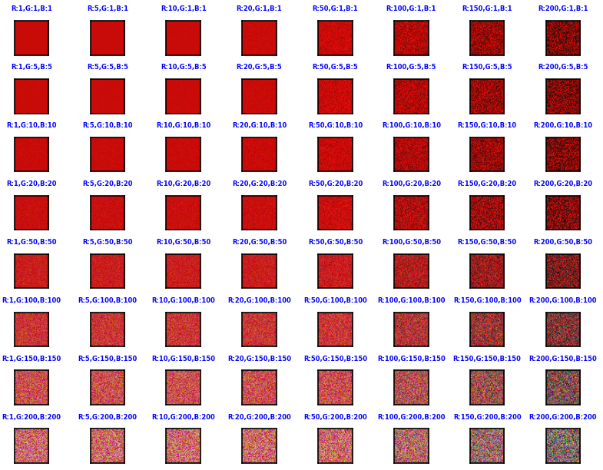

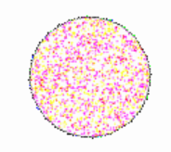
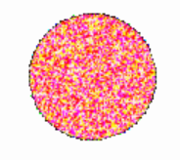

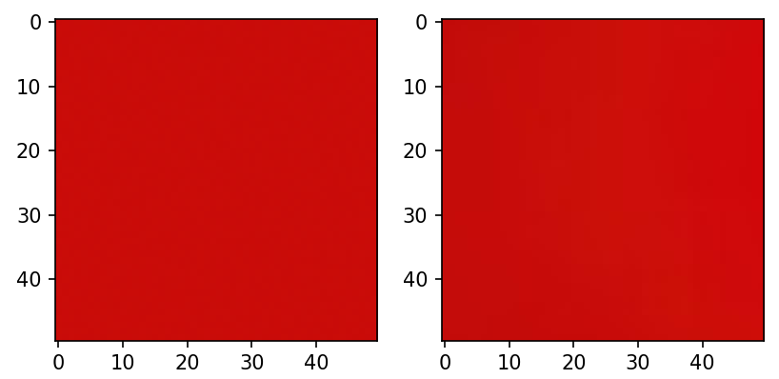
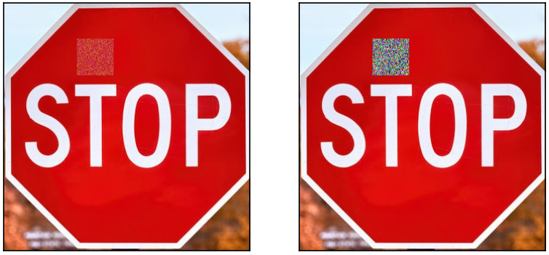
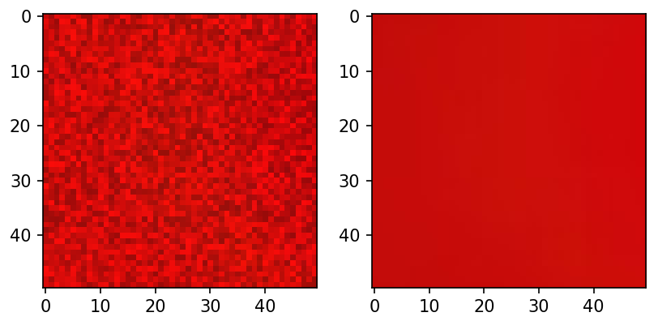
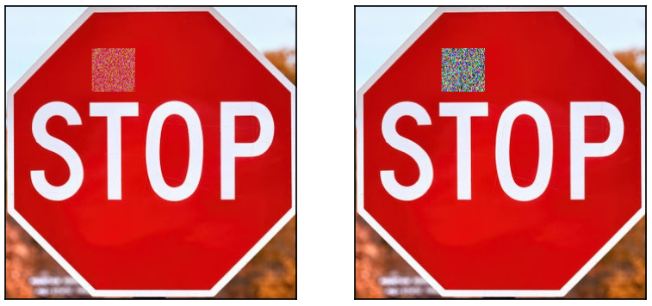
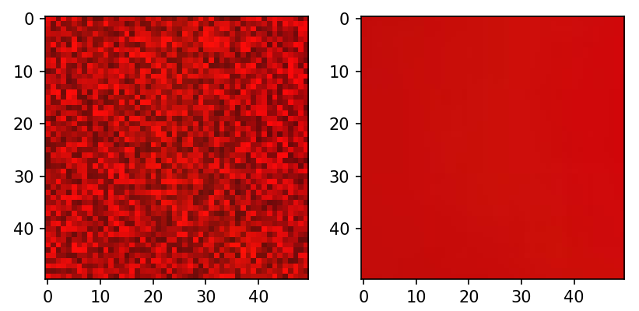
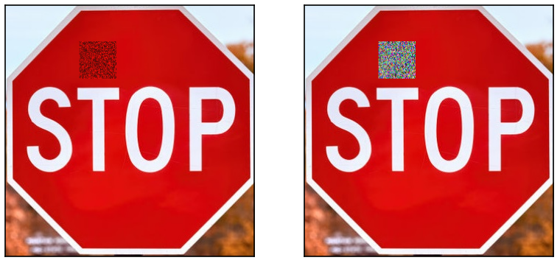
AdversarialColorPatch – Colour [R1]
Problem: We must be able to define an adversarial patch related to the colour of the target in order
to minimize its visibility when applied.
Solution: We can approximate the initial colour of the adversarial patch based on the Mean (average) of the values of the three channels for each pixels of the target . We can additionally, the amount of pixels with the identical values, retrieve the highest, and provide based on the two values, the base colour of the adversarial patch.
In order to preserve the efficiency of an attack with the AdversarialColorPatch, we must allow a threshold, and , comprised in the upper and lower bound, from the initial colour of the adversarial patch. Therefore, we must experiment different modification of the original values for the channels , and acquire an ideal threshold definition based on the actual main channel colour .
Ideal threshold →
Warning: We can not apply this threshold to black and white!
Ideal B/W threshold →

Slide 11
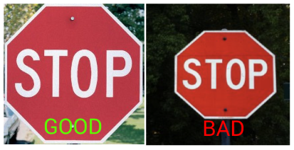
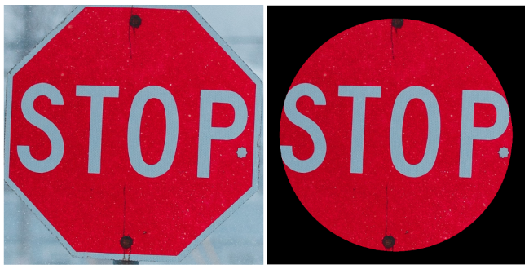
AdversarialColorPatch – Colour (2) [R1]
We have defined and provided a method for an adversarial patch to obtain a colour domain similar to the attacked target.
However, we have experimented on perfect colour background!
We must be aware that the background of an image have the capability to highly perturb this
method of colour domain calculation, as the pixels values would eventually alter the final results. Consequently, it would intervene on an artificial intelligence model prediction. Due to this fact, we have defined the presence of two restrictions for an attacked image, position and form.
Position – The first restriction is based on the position of the attacked object on the image . Indeed, we may need to act on the manipulation of the image in order to assure that an attacked object is centred on the picture, and additionally near to it. This approach is allowing to minimize a considerable amount of the
background.
Form – The second restriction is about disposing the remaining of the background on the
image, as it would surely still impact our method. Indeed, the road traffic signs
have been designed with different forms (circle, square, triangle), and therefore
some background may persists afterwards the first restriction. In this case, we have
encountered this issue by additionally defining a parameter, that must be set during
the attack, allowing to determine three different forms (circle, square, triangle)
for the image. This procedure allows to remove the background by reducing the
research area for the colour domain based on the form provided.

Slide 12




AdversarialColorPatch – Attacks
The implementation of AdversarialColorPatch provides three distinct types of attacks, allowing a diversity regarding the objective and/or goal of the consumer, and therefore defined with different objective functions for the genetic algorithm attack (still based on the square error) : target attack, untarget attack and best attack.
Target Attack - In the target attack scenario, adversarial patches must be able to miss-classify
the model to a specific target label. Therefore, the objective function is
defined as maximizing the target label probability while minimizing all the
others labels probability. As said earlier, the objective function is based on
the square error between two sets of probabilities, the prediction by the model
, and the target prediction we want to obtain, therefore the goal is
to obtain and objective function outputting .
Untarget Attack - In the untarget attack scenario, adversarial patches must be able to miss-
classify the model as far as possible from the original label. Therefore, the
objective function is defined as maximizing all the labels probability while
minimizing the original label probability. In comparison to target attack, in
this situation we are not concerned about the class of label the model has
classified the image into, as long as the original label is not predicted
anymore.
Best Attack - In best attack scenario, compared to the other attacks, the objective is to
provide an adversarial patch capable to miss-classify the model in the label,
different from the original one, with the highest probability. We can define the
best attack as an evolving target attack, as the label with the highest
probability will be prioritized at each generation and therefore will be
modified adequately.
(example for each attacks on the blackboard)

Slide 13
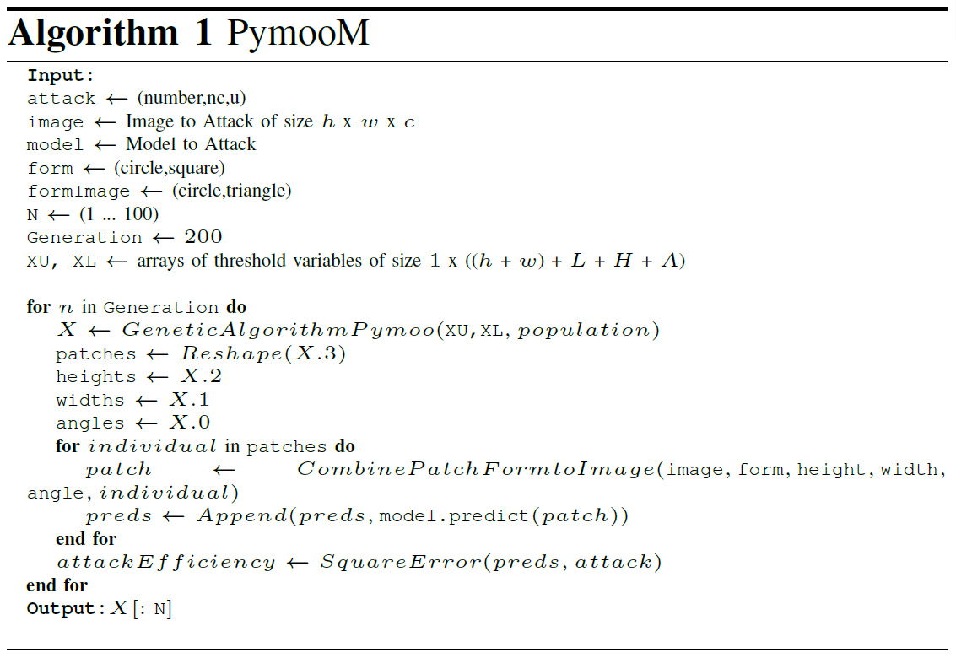
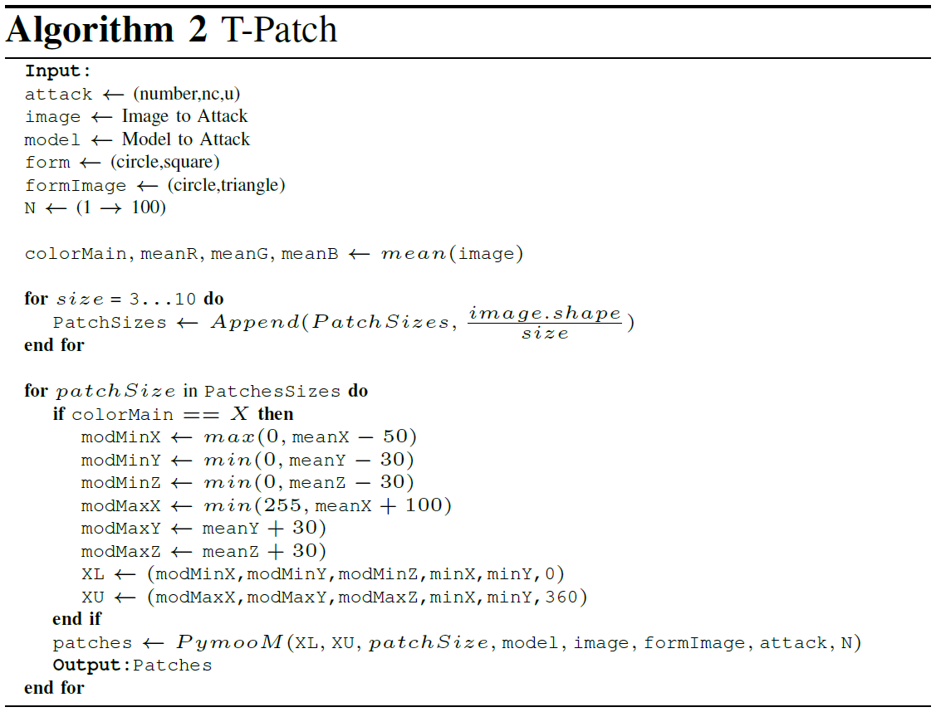
AdversarialColorPatch – Algorithm
Hyperparameters Settings
Represents the parameters that have been defined by the user at the beginning of the AdversarialColorPatch attack (type of attack, image to attack, model, form of the adversarial patch, form of the target).
(2) Attack with Pymoo Genetic Algorithm
Represents the Pymoo genetic algorithm applied to produce the adversarial patches, and the
retrieving of the results (adversarial patches, position, angles)
(3) Apply Adversarial patches and evaluate attack efficiency on Objective function
Represents the application of the adversarial patches on the target image based on its content, the position and the angles produced by Pymoo. Followed, by an evaluation of the objective function (regarding the chosen attack type) based on the efficiency of the attack with the current adversarial patches.
(4) Hyperparameters Settings
(see (1))
(5) Target image colour definition
Represents the acquisition of the initial colour domain for the adversarial patch based on the target image via the two methods defined earlier.
(6) Adversarial Patches sizes definition
Represents the acquisition of the different sizes for the adversarial patches based on the original size of the target image. Allows to obtain, produce and apply adversarial patches of multiples sizes.
(6) Adversarial Patches colour definition
Define the threshold of the colour domain for the adversarial patches based on the ideal threshold defined earlier.
(7) Apply PymooM Algorithm
Apply the steps with the parameters defined by the user.

Slide 14
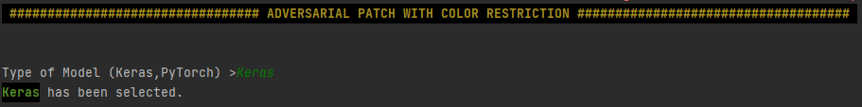
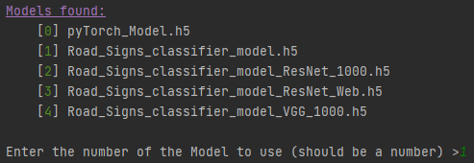
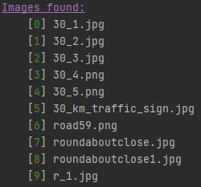

AdversarialColorPatch - Example
Set the Model Type (Keras,PyTorch)
(3) Choose the Attack Type (Target, Untarget, Best)
(3) Choose the Adversarial Patch Form (Circle,Square,Triangle)
(2) Choose the Model
(3) Choose the Target Form (Circle,Square,Triangle)
(3) Choose the Target Image
(3) Choose the Amount of Adversarial Patches to produce

Slide 15
Metrics of Evaluation
In order to evaluate the efficiency of the AdversarialColorPatch, we have defined three metrics of evaluation that will be reviewed along the observed results.
Time - The time metric (TM) is contributing to evaluate the amount of time needed to produce the adversarial patches. To
achieve this, we have evaluated the time needed to create exactly one adversarial patch (uncomplete attack), the time
needed to create all the adversarial patches (full attack), and defined the existence of a relation based on the size
of the image attacked.
Similarity Index - Multiples Similarity Index metric (SSIM, SCC, VIFP, UQI) are provided to evaluate the similarity value
between two images, and is based on the image degradation change in its quality information. We are using
these metric to evaluate the efficiency of colour restriction defined and observe the adversarial patch
transparency, by comparing the original image , and the image integrated with the adversarial patch .To
obtain accurate results, this metric is being evaluated simulating the distance from the attacked target
traffic sign (slowly resizing the image), and calculated as soon as the traffic sign has been detected. A
threshold for each of the similarity metrics is set, such that the value obtained should stay above a
given objective. This metric will provide a simple simulation evaluation of the time needed for the human
to visualize the attack on the traffic sign.
Attack Accuracy - The Attack Accuracy (AA) is evaluating the efficiency of the adversarial patches created by our
implementation based on Pymoo. This metric is calculated based on the percentage of successfully created
patches on the different types of attacks (target,untarget,best), observing the amount of labels which
manage to change successfully over a specific probability, and finally based on the form of the adversarial
patches. (circle, square, triangle).

Slide 16
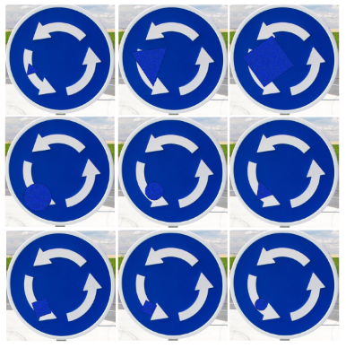
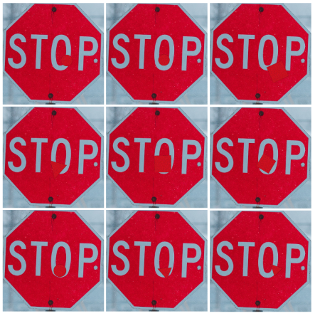
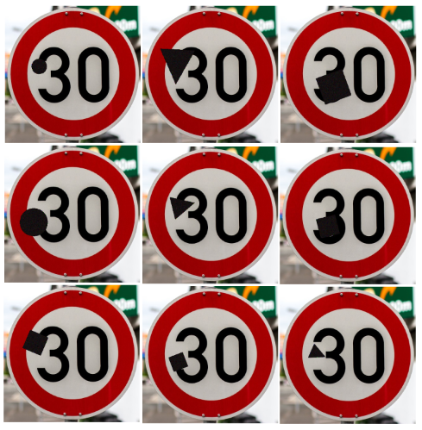
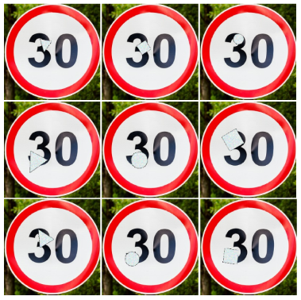
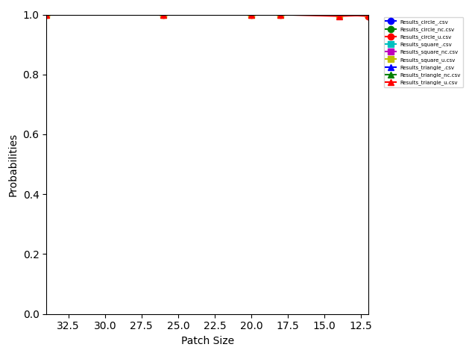





Results [R2 + R3 + M3]

Slide 17





Results [M2]
To evaluate the similarity index metrics (SSIM, SCC, VIFP, UQI) for the AdversarialColorPatch, we have compared the difference of visibility between the original target and the attacked target with the adversarial patch, for each of the traffic signs.
For each of the similarity metrics, the calculation is providing a defined value according to how two evaluated images are similar, the values are restricted between the two extremes and , such that refers to two identical images (can be obtained by evaluating twice the same image), and referring to two totally different images. For our evaluation of an adversarial patch transparency efficiency, the value must be higher than 0.95 for all similarity metrics in order to be defined as a successful attack fulfilling the visibility requirement.
Small patch
SSIM – 0.99
SCC – 0.98
UQI – 0.99
VIFP – 0.98
Large patch
SSIM – 0.90
SCC – 0.88
UQI – 0.95
VIFP – 0.87
Small patch
SSIM – 0.98
SCC – 0.97
UQI – 0.99
VIFP – 0.97
Large patch
SSIM – 0.91
SCC – 0.88
UQI – 0.96
VIFP – 0.93
Small patch
SSIM – 0.99
SCC – 0.98
UQI – 0.99
VIFP – 0.96
Large patch
SSIM – 0.89
SCC – 0.89
UQI – 0.97
VIFP – 0.84
Small patch
SSIM – 0.99
SCC – 0.95
UQI – 0.98
VIFP – 0.98
Large patch
SSIM – 0.92
SCC – 0.87
UQI – 0.90
VIFP – 0.86

Slide 18








Comparison with alternative Attacks [M1]
We have operated with three well known adversarial patches attacks approaching the operation of our AdversarialColorPatch attack : AdversarialPatch[AP], SaliencyMap[SM] and CarliniMethod[CM].
These attacks are allowing us to observe the possible assets and disadvantage of each individual attack, and define an accurate efficiency map. We are applying a set of traffics signs (stop, roundabout, speed) and analysed the obtained results based on three major attributes : time - necessary time to apply the attack, attack efficiency - rate of success of the attack based on if the prediction have been altered, and patch visibility.

Slide 19



Limitations and Future work
The AdversarialColorPatch current implementation and efficiency, is restricted by a few limitations that have been observed during the experiments and results obtained. We are detailing their causes and consequences in order to define the future work to be accomplished to minimize nay lift these limitations.
Efficiency of Target Attack
We have observed a negligence for the capability of the ACP attack to provide adversarial patches with the target attack. It seems to be due to the type of image attacked compared to the chosen targeted label; Speed traffic obtained correct few adversarial patches applicable, while the Stop Sign did not. However, Untarget attack was successful for all traffic signs.
Actually, when applying the target attack we must be conscientious of the target label chosen. Assume, a Stop Sign (octogon, red, letters) to target a label to a Pedestrian Sign (triangle, blue, stickman), the attack will likely fail due to a great difference between both of the signs. This limitation is quite critical as it does not allow us to freely choose the target label.
Target Restriction
The efficiency of the ACP algorithm is based on a specific position of the target attacked, allowing us to focus on the desired attacked object, situated in the middle of the image. Evolving around traffic signs we can encounter on public roads, we restricted the type of forms (circle, square, triangle) for the adversarial patches.
This limitation is fairly critical as, based on the evolution of the traffic signs forms (rectangle,multiples signs) and/or attacks with other models, the flexibility of the adversarial patches would require further improvement and modification availability to fulfil its requirements.
Time
We have observed that ACP required between and minutes to create a single adversarial patch (based on the size of the attacked image). This time is relative to the size of the image attacked, as the bigger it is, the more pixels modifications on the adversarial patch and research area domain is required, consequently elongating the process time.
This critical feature of AdversarialColorPatch is due to the fact we are evolving in the black-box attacks domain, and applying a random search using a compact adversarial patch (pymoo), therefore the convergence towards the objective function optimum value may require more time to find the optimal route, as adversarial patches modification may or may not improve the attack efficiency at each generation.

Slide 20
Conclusion

Slide 21
Thank you for listening!

